Slide 1
Introduction
to Probability
Slides adapted from OpenIntro by Francesca Mangili

Slide 2
Random experiment
A random experiment is an experiment in which we know what outcomes could happen, but we don't know which particular outcome will happen.
Examples: coin tosses, die rolls, iTunes shuffle, whether the stock market goes up or down tomorrow, etc.
The set of all possible outcomes of a random process is called Sample space Ω.
A subset of Ω is called event. An event can also be described as a statement about an attribute of the outcome (e.g., the event A:= “the outcome of the die roll is odd” corresponds to the subset {1,3,5} of the sample space Ω={1,2,3,4,5,6}.
We may wish to describe the likelihood of the different possible outcomes of an experiment → We introduce the notion of probability

Slide 3
Probability
Probability is a mathematical concept used to describe uncertain events.
There are several possible interpretations of probability but they agree on the mathematical rules probability must follow:
Let P(A) be the probability of event A. It holds,
0 ≤ P(A) ≤ 1
P(A) = 0 means that A cannot happen
P(A) = 1 means that A will certainly happen.
The probability assigned to the set of all possible outcomes Ω is P(Ω) = 1.

Slide 4
Probability - example
Let’s consider the process of tossing a coin
Ω = {head, tail}
Consider the two events A = ‘tail at the next die roll’, and B = ‘head at the next die roll’
For a fair coin P(A) = P(B) = 0.5
P(A and B) = 0
P(A or B) = P(𝛺) = 1

Slide 5

Distribution function
If Ω is finite (i.e., the random experiment has a finite number of possible outcomes) we can define the function p(ω): Ω → [0,1] which assigns to all possible outcome its probability.
We call such function discrete distribution function or probability mass function (pmf) over Ω.
The pmf satisfies the following contraint:
non negativity: p(ω)≥0
normalization:

Slide 6
Probabilities from thought experiments
Sometimes the probability of a event can be derived theoretically given some assumptions.
Examples:
In the case of a fair coin, we assume (since it is fair) that the probability of head is the same as the probability of tail:
P(H) = P(T). Since head and tail are the only two possible outcomes, i.e., Ω = {H, T}, it also hold: P(H) + P(T) = 1. Then, P(H) = P(T) = 0.5
If we random sample from a population and assume each individual has the same probability of being sampled, the probability of an event (e.g., the event A:= “the individual is taller than 1.7m”) is equal to the relative frequency of the individuals satisfying the proposition.
In general, given a set of n equally probable possible outcomes, the probability of the event A can be computed by considering the number n_{A} of outcomes favorable to A:
P(A) = n_{A}/n = f_{A}

Slide 7
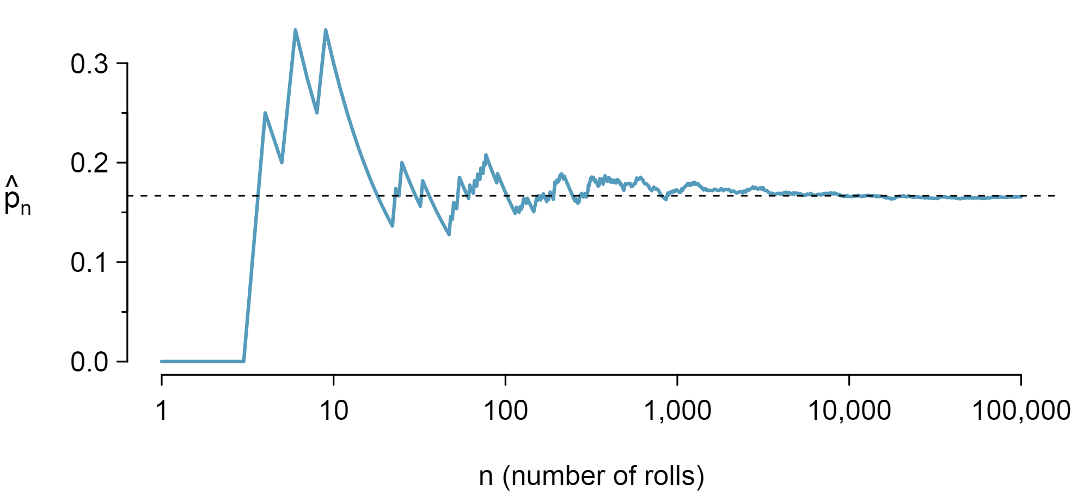
Frequentist interpretation of probability
The probability of an outcome is the proportion of times the outcome would occur if we observed the random process an infinite number of times.

Slide 8
Random variables
A random variable is a function associating a numerical value to the outcome of an experiment/random process
We use a capital letter, like X, to denote the random variable
The numerical value assumed by the random variable when the outcome is ω ∈ Ω is denoted with the lowercase letter: x = X(ω)
There are two types of random variables:
Discrete random variables often take only integer values
Example: number of sons, outcome of a dice roll,...
Continuous random variables take real values
Example: Cost of books this term, Difference in cost of books this term vs last

Slide 9
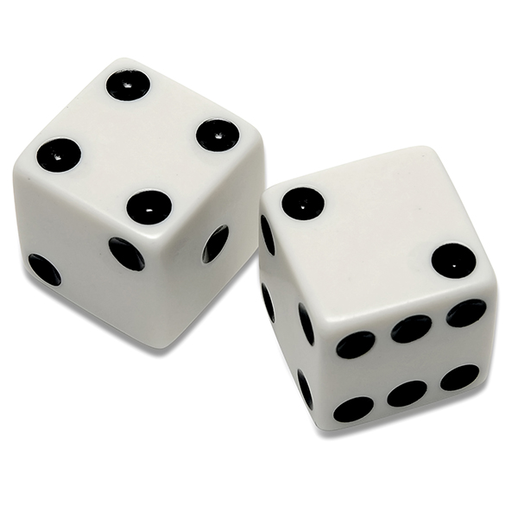
Random variables - example
Experiment: rolling two dice
X: number of dots on the first die
Y: number of dots on the second die
Z = X+Y: total number of dots on the two dice
Outcome ω =
X( ) = x = 4 Y( ) = y = 2 Z( ) = x + y = 6

Slide 10
Distribution of a random variable
From the probability distribution defined over Ω, we can derive the probability distribution of X which assigns a probability to all possible events defined as statements on X (e.g., X ∊ E).

Slide 11
Example: finite sample space
Experiment: we toss a dice and look at the number of dots in the upper face
Ω = {1,2,3,4,5,6}
Assuming that all faces are equally likely to come up p(ω) = 1/6 for all ω ∈ Ω
Let’s define the random variable X taking value 1 if the outcome is larger than 1 and 0 otherwise.
All possible events over X are {0},{1},{0,1}.
From the probability distribution over Ω we can derive the probability of all events:
Prob({0})= Prob(ω ∈ {2,3,4,5,6}) = 5/6,
Prob({1})= Prob(ω ∈ {1}) = 1/6,
P({0,1}) = Prob(ω ∈ {1,2,3,4,5,6}) = 1

Slide 12
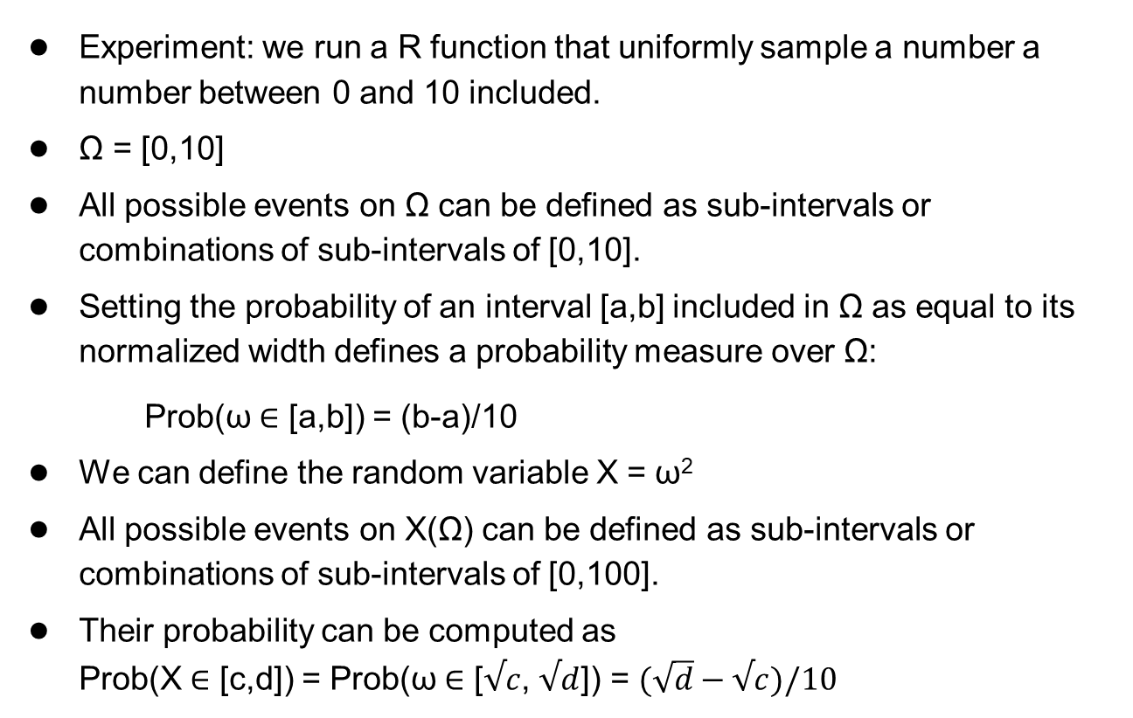
Example: infinite sample space
Experiment: we run a R function that uniformly sample a number a number between 0 and 10 included.
Ω = [0,10]
All possible events on Ω can be defined as sub-intervals or combinations of sub-intervals of [0,10].
Setting the probability of an interval [a,b] included in Ω as equal to its normalized width defines a probability measure over Ω: Prob(ω ∈ [a,b]) = (b-a)/10
We can define the random variable X = ω²
All possible events on X(Ω) can be defined as sub-intervals or combinations of sub-intervals of [0,100].
Their probability can be computed as Prob(X ∈ [c,d]) = Prob(ω ∈ [$√c$, $√d$]) = $(\sqrt{d}−√c)/10$

Slide 13
Combining events

Slide 14
Probability - set theory
In many cases, events can be described in terms of other events through the use of the standard constructions of set theory.
Ω
Ω
= Ω\A=¬A
= A⋂B
A
B
Both A and B happen
A
B
Event A does not happen.
Ω\A is also called the complementary event of A
Ω
= A⋃B
Either event A or B (or both) happen
A
B

Slide 15
Probability - set theory
How do you interpret event A\B?
S
= A\B
A
B

Slide 16
Probability - set theory
How do you interpret event A\B?
S
= A\B
A
B
Event A happens while B does not happen

Slide 17
Disjoint and non-disjoint events
Disjoint (mutually exclusive) events: Cannot happen at the same time.
The outcome of a single coin toss cannot be a head and a tail.
A student both cannot fail and pass a class.
A single card drawn from a deck cannot be an ace and a queen.
Two events A and B are disjoint if A⋂B = ∅

Slide 18
Disjoint and non-disjoint outcomes
Disjoint (mutually exclusive) events: Cannot happen at the same time.
The outcome of a single coin toss cannot be a head and a tail.
A student both cannot fail and pass a class.
A single card drawn from a deck cannot be an ace and a queen.
Two events A and B are disjoint if A⋂B = ∅
If A⋂B ≠ ∅ it means that A and B are non-disjoint events, i.e., they can happen together:
A student can get an A in Stats and A in Econ in the same semester.

Slide 19
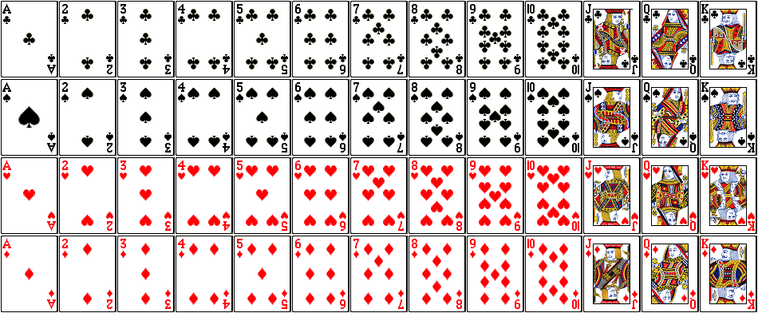
Union of disjoint events
What is the probability of drawing a jack or a queen from a well shuffled full deck?
P(jack or queen) = P(J⋃Q) = P(J) + P(Q) = 4/52 + 4/52
Figure from http://www.milefoot.com/math/discrete/counting/cardfreq.htm

Slide 20
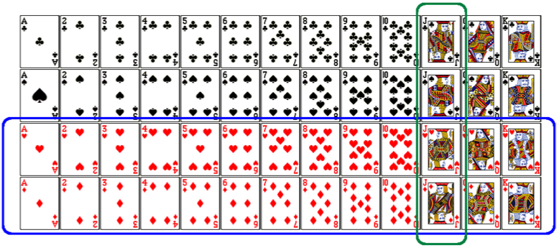
Union of non-disjoint events
What is the probability of drawing a jack or a red card from a well shuffled full deck?
Figure from http://www.milefoot.com/math/discrete/counting/cardfreq.htm

Slide 21
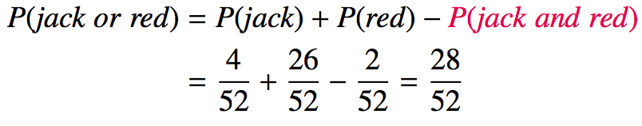
Union of non-disjoint events
What is the probability of drawing a jack or a red card from a well shuffled full deck?
Figure from http://www.milefoot.com/math/discrete/counting/cardfreq.htm

Slide 22
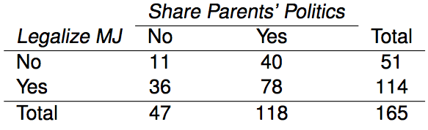
Practice
What is the probability that a student randomly sampled from the 165 considered in the table thinks marijuana should be legalized or agrees with his/her parents' political views?
(a) (40 + 36 - 78) / 165
(b) (114 + 118 - 78) / 165
(c) 78 / 165
(d) 78 / 188
(e) 11 / 47

Slide 23
Practice
What is the probability that a student randomly sampled from the 165 considered in the table thinks marijuana should be legalized or agrees with his/her parents' political views?
(a) (40 + 36 - 78) / 165
(b) (114 + 118 - 78) / 165
(c) 78 / 165
(d) 78 / 188
(e) 11 / 47

Slide 24
Recap
General addition rule
P(A or B) = P(A) + P(B) - P(A and B)
Note: For disjoint events P(A and B) = 0, so the above formula simplifies to P(A or B) = P(A) + P(B)

Slide 25
Independence
Two processes are independent if knowing the outcome of one provides no useful information about the outcome of the other.

Slide 26
Independence
Two experiments are independent if knowing the outcome of one provides no useful information about the outcome of the other.
Knowing that the coin landed on a head on the first toss does not provide any useful information for determining what the coin will land on in the second toss. >> Outcomes of two tosses of a coin are independent.

Slide 27
Independence
Two experiments are independent if knowing the outcome of one provides no useful information about the outcome of the other.
Knowing that the coin landed on a head on the first toss does not provide any useful information for determining what the coin will land on in the second toss. >> Outcomes of two tosses of a coin are independent.
Knowing that the first card drawn from a deck is an ace does provide useful information for determining the probability of drawing an ace in the second draw. >> Outcomes of two draws from a deck of cards (without replacement) are dependent.

Slide 28
Practice
Between January 9-12, 2013, SurveyUSA interviewed a random sample of 500 NC residents asking them whether they think widespread gun ownership protects law abiding citizens from crime, or makes society more dangerous. 58% of all respondents said it protects citizens. 67% of White respondents, 28% of Black respondents, and 64% of Hispanic respondents shared this view. Which of the below is true?
Opinion on gun ownership and race ethnicity are most likely
(a) complementary
(b) mutually exclusive
(c) independent
(d) dependent
(e) disjoint
http://www.surveyusa.com/client/PollReport.aspx?g=a5f460ef-bba9-484b-8579-1101ea26421b

Slide 29
Practice
Between January 9-12, 2013, SurveyUSA interviewed a random sample of 500 NC residents asking them whether they think widespread gun ownership protects law abiding citizens from crime, or makes society more dangerous. 58% of all respondents said it protects citizens. 67% of White respondents, 28% of Black respondents, and 64% of Hispanic respondents shared this view. Which of the below is true?
Opinion on gun ownership and race ethnicity are most likely
(a) complementary
(b) mutually exclusive
(c) independent
(d) dependent
(e) disjoint
http://www.surveyusa.com/client/PollReport.aspx?g=a5f460ef-bba9-484b-8579-1101ea26421b

Slide 30
Product rule for independent events
P(A and B) = P(A) x P(B)
Or more generally, P(A₁ and A₂ … and A_{k}) = P(A₁)P(A₂)…P(A_{k})

Slide 31
Product rule for independent events
P(A and B) = P(A) x P(B)
Or more generally, P(A₁ and A₂ … and A_{k}) = P(A₁)P(A₂)…P(A_{k})
You toss a coin twice, what is the probability of getting two tails in a row?

Slide 32
Product rule for independent events
P(A and B) = P(A) x P(B)
Or more generally, P(A₁ and A₂ … and A_{k}) = P(A₁)P(A₂)…P(A_{k})
You toss a coin twice, what is the probability of getting two tails in a row?
P(T on the first toss) x P(T on the second toss) = ½ x ½ =¼

